Slide 1






WELCOME TO LESSON
8 February, 2017

Slide 2

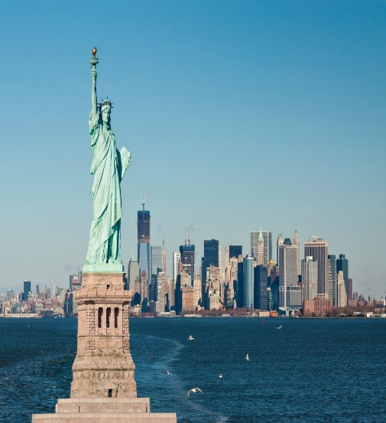
Guessing word
A
M
E
I
C
A
R
1. It is a country in the world.
2. IT HAS 7 LETTERS, BEGIN WITH LETTER “A”.

Slide 3




Unit 12: A VACATION ABROAD
Period 75: Lesson 4: READ

Slide 4

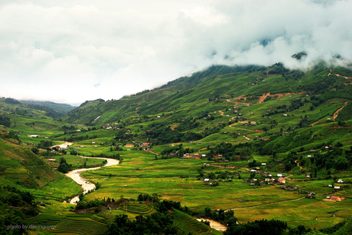
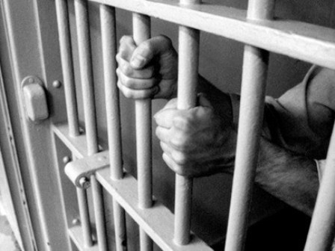
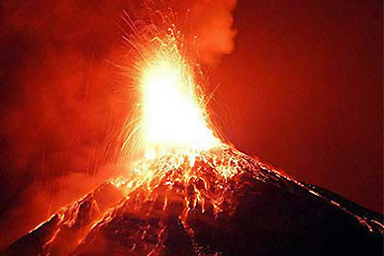
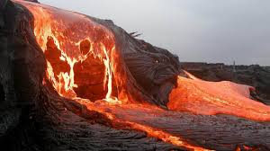
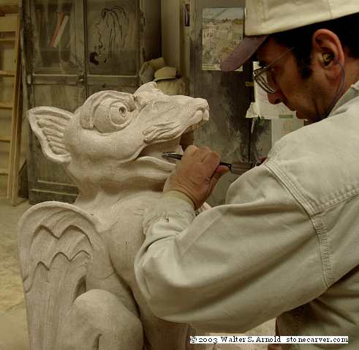
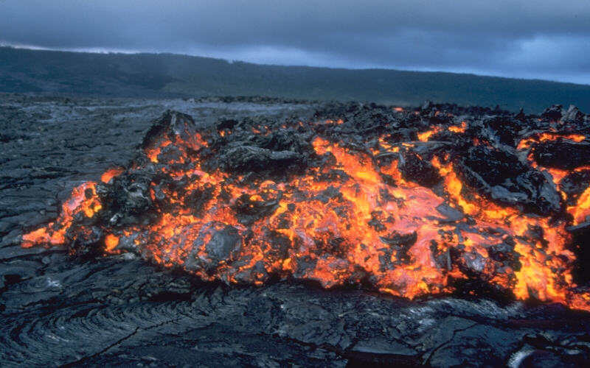
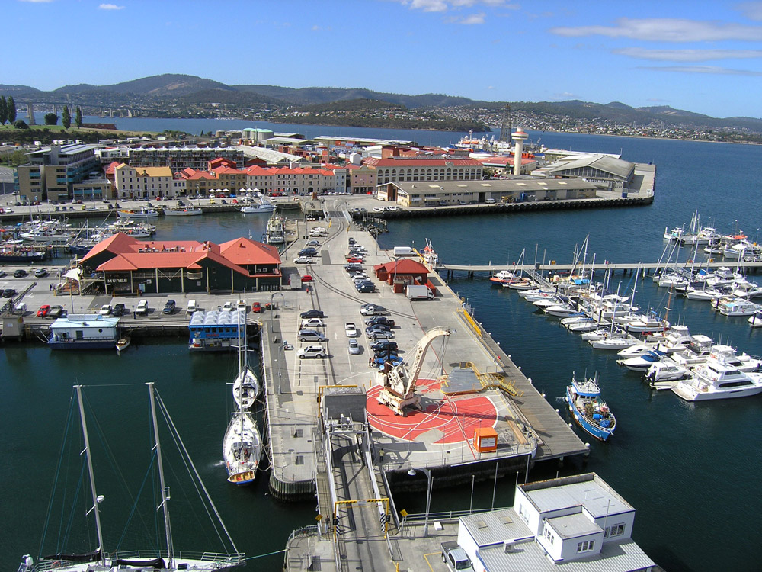
Unit 12: A VACATION ABOARD
Period 75: Lesson 4: READ.
1. Vocabulary:
Volcano (n) :
Lava (n) :
(to) pour out (v):
Sightseeing (n):
Valley (n) :
Wharf (n):
Overhead (adv):
Prison (n):
Carve (n):
núi lửa
dung nham
What is another word of “above the head”?
đổ ra, tràn ra
cuộc tham quan
thung lũng
cầu tàu, cầu cảng
phía trên đầu
nhà tù
chạm khắc

Slide 5
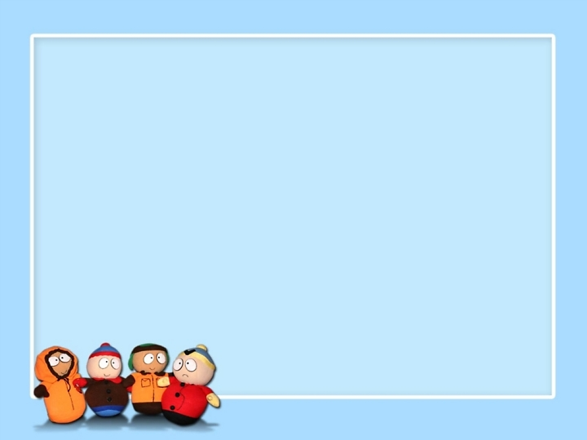

Unit 12: A VACATION ABOARD
Period 75: Lesson 4: READ.
Leave me out
Volocano
Larva
pour outt
Sightseeeing
Vaelley
Wharft
Overheard
Prision
Carved
Volcano
Lava
pour out
Sightseeing
Valley
Wharf
Overhead
Prison
Carve

Slide 6

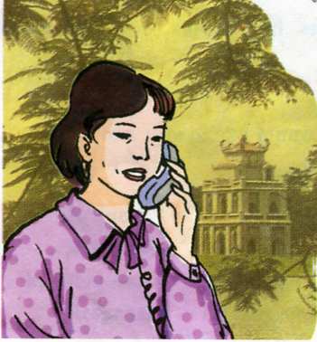
Unit 12: A VACATION ABOARD
Period 75: Lesson 4: READ.
Mrs. Quyen and her husband are traveling around America. They have just visited many famous places.

Slide 7
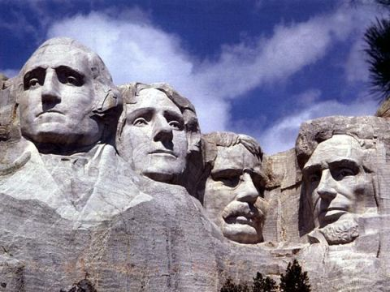
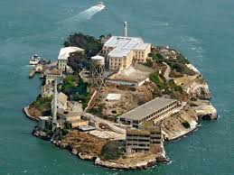
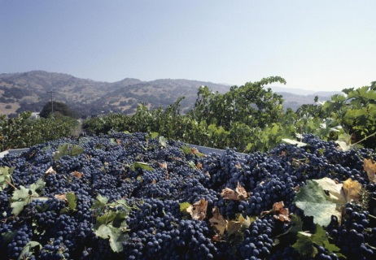
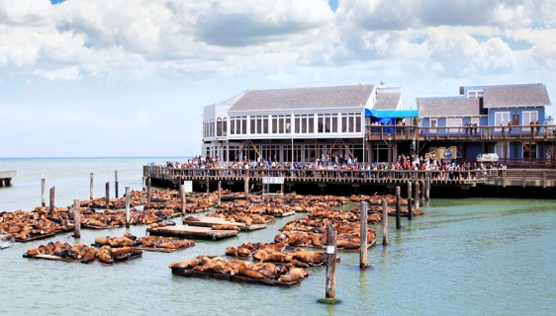
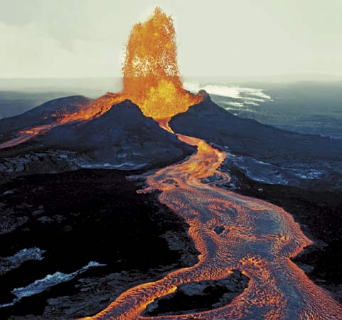
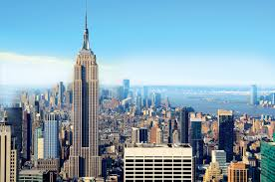
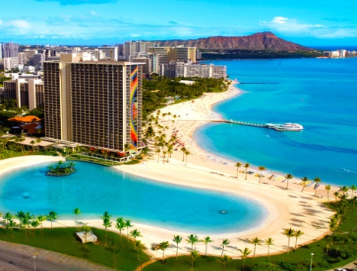
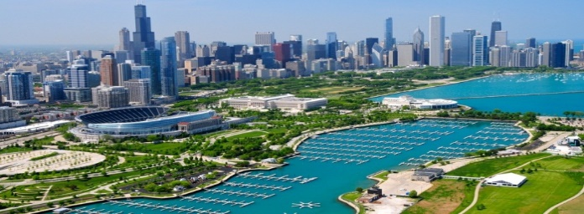
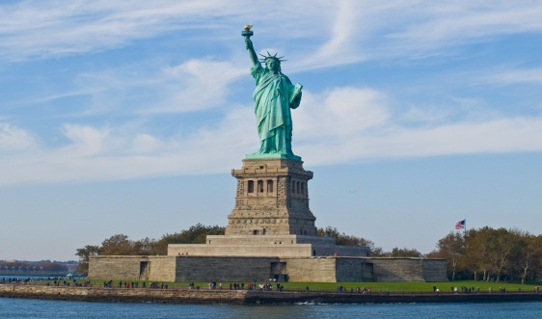
Hawaii
San Francisco
Mount Rushmore
Chicago
New York
A. Mount rushmore
F. Alcatraz prison
B. Napa Valley
G. Fisherman’s Wharf
C. Kilauea Volcano
H. Empire State Building
D. Waikiki Beach
E. Lake Michigan
I. The Statue of Liberty

Slide 8
1. San Francisco
2. Hawaii
A. Mount rushmore
F. Alcatraz prison
3. Mount rushmore
B. Napa Valley
G. Fisherman’s Wharf
4. New York
5. Chicago
C. Kilauea Volcano
H. Empire State Building
D. Waikiki Beach
E. Lake Michigan
I. The Statue of Liberty

Slide 9


Predict places Mrs. Quyen and her husband visited.
 | Places Mrs. Quyen and her husband visited | Predict | Read
a | Waikiki Beach | √
b | Kilauea Volcano | √
c | Napa Valley | √
d | Golden Gate Bridge | √
e | Alcatraz prison | √
f | Fisherman’s Wharf | √
g | Mount Rushmore | √
h | The Statue of Liberty | √
i | The Empire State Building | √
k | Lake Michigan | √
l | The Great Wall | √

Slide 10
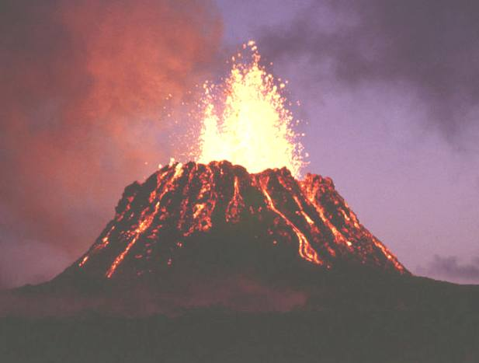
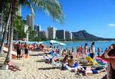
Unit 12: A VACATION ABOARD
Period 75: Lesson 4: READ.
Read these postcards from Mrs. Quyen to her children.
We went swimming at Waikiki Beach as soon as we arrived on the Hawaiian island of Oahu. We took a small plane to Kilauea Volcano this afternoon. The lava was pouring out when we flew overhead. It was very exciting.

Slide 11
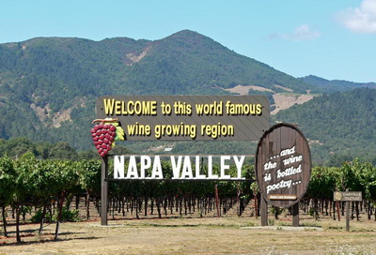
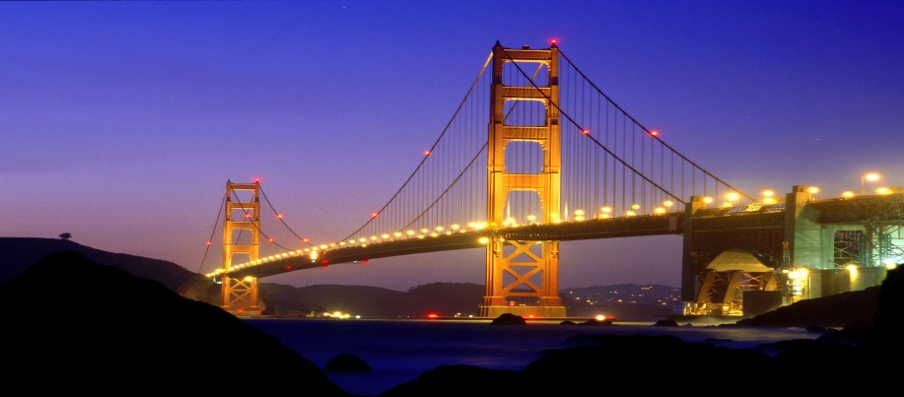
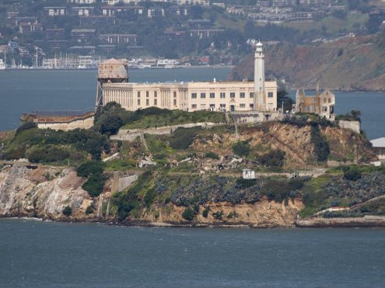
Unit 12: A VACATION ABOARD
Period 75: Lesson 4: READ.
Today we went on an eight-hour tour which included Fisherman’s Wharf, the Napa Valley wine-growing area, and the famous prison on the island of Alcatraz in the middle of San Francisco Bay.

Slide 12
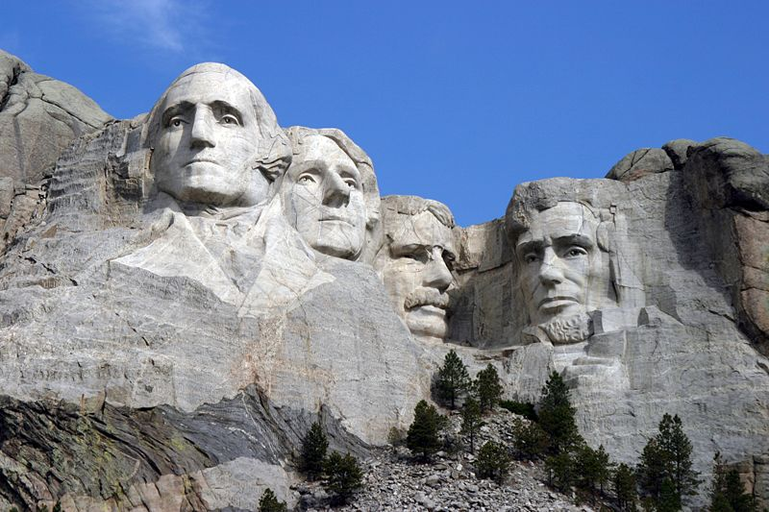
Unit 12: A VACATION ABOARD
Period 75: Lesson 4: READ.
This is a picture of Mount Rushmore where the heads of four American presidents are carved into the rock. Mount Rushmore can be seen from more than 100 kilometers away.

Slide 13
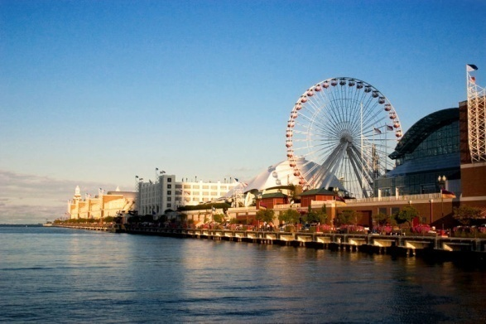
Unit 12: A VACATION ABOARD
Period 75: Lesson 4: READ.
Chicago is often called “The Windy City”. It’s situated right on the shore of Lake Michigan, one of the Great Lakes.

Slide 14
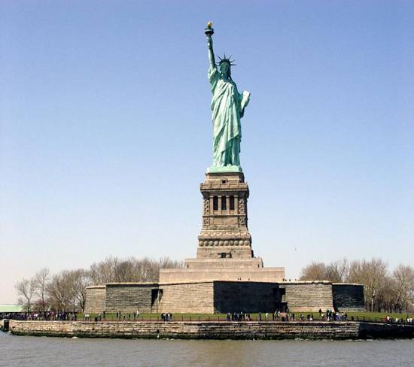
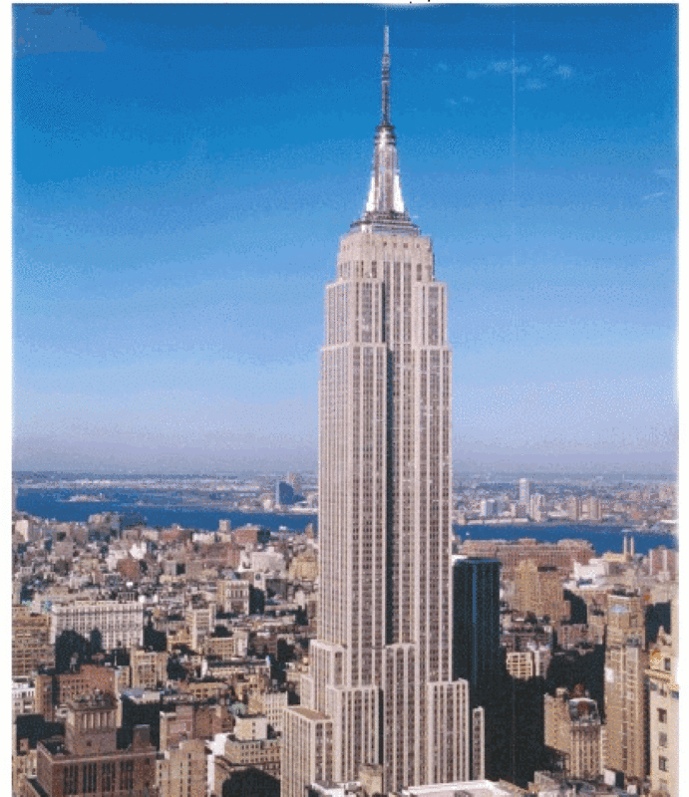
Unit 12: A VACATION ABOARD
Period 75: Lesson 4: READ.
Yesterday, while Dad was visiting the Statue of Liberty and the Empire State Building, I went shopping. I bought lots of souvenirs of our trip.

Slide 15
 | Places Mrs. Quyen and her husband visited | Predict | Read
a | Waikiki Beach
b | Kilauea Volcano
c | Napa Valley
d | Golden Gate Bridge
e | Alcatraz prison
f | Fisherman’s Wharf
g | Mount Rushmore
h | The Statue of Liberty
i | The Empire State Building
k | Lake Michigan
l | The Great Wall
√
√
√
√
√
√
√
√
√

Slide 16
1. Write what Mrs. Quyen did and saw in each of these places.
Place | What she did and saw
a. Hawaii
b. New York
c. Chicago
d. Mount Rushmore
e. San Francisco
Went swimming, visited Kilauea Volcano.
Went shopping, bought lots of souvenirs.
Saw Lake Michigan.
Saw the heads of four American presidents.
Visited Fisherman's Wharf, the Napa Valley wine-growing area and the Alcatraz prison.

Slide 17
ANSWER THE QUESTIONS
How did Mrs. Quyen go to Kilauea Volcano?
She went there by plane.
b) Where in San Francisco did Mrs. Quyen see the famous prison?
She saw the famous prison on the island of Alcatraz.
c) What is special about Mount Rushmore?
It is a mount where the heads of four American presidents are carved into the rock.
d) What is the other name of Chicago?
It is also called “The Windy City”.
e) What did Mrs. Quyen do while her husband was visiting the Statue of Liberty?
She went shopping.

Slide 18
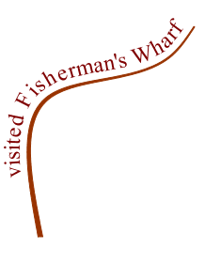
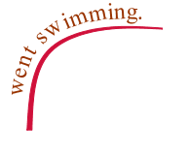
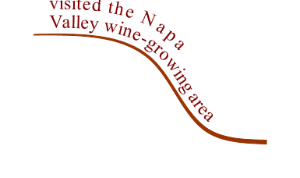


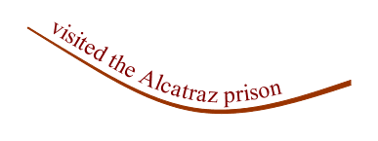
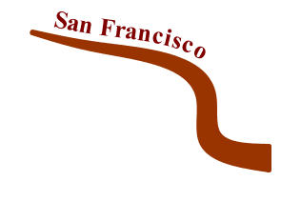
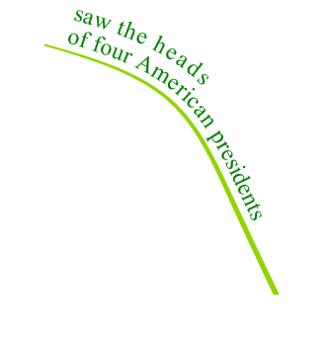




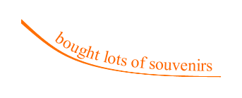


Retell
Ex:In Hawaii, she went swiming and visited Kilauea Volcano.

Slide 19

Homework
Learn new words by heart.
Read the postcards again.
Do exercises 1,2 / p 117-118

Slide 20



