Slide 1
Welcome to lesson!

Slide 2
What’s this place?

Slide 3
ĐÀ LẠT
It is called the city of Eternal Spring.
2. It has a lot of waterfalls and lakes
3. You can find the most kinds of flowers here

Slide 4
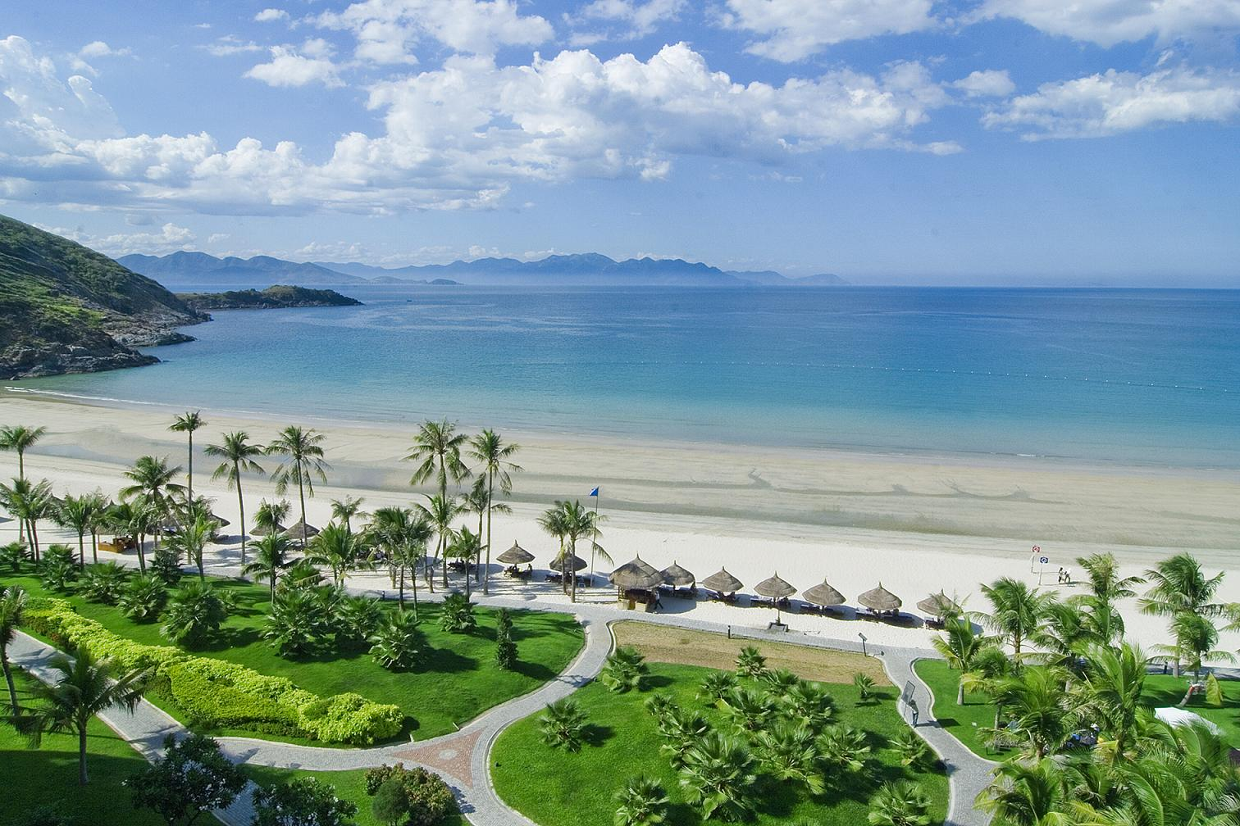
NHA TRANG
1 . It’s a seaside resort
2. It has a very big monument of Buddha
3. It has an Oceanic Institute

Slide 5
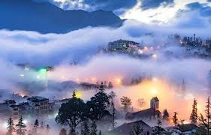
SAPA
1. It is a mountainous resort
2. It has tribal villages
3 . Sometimes it has snow

Slide 6
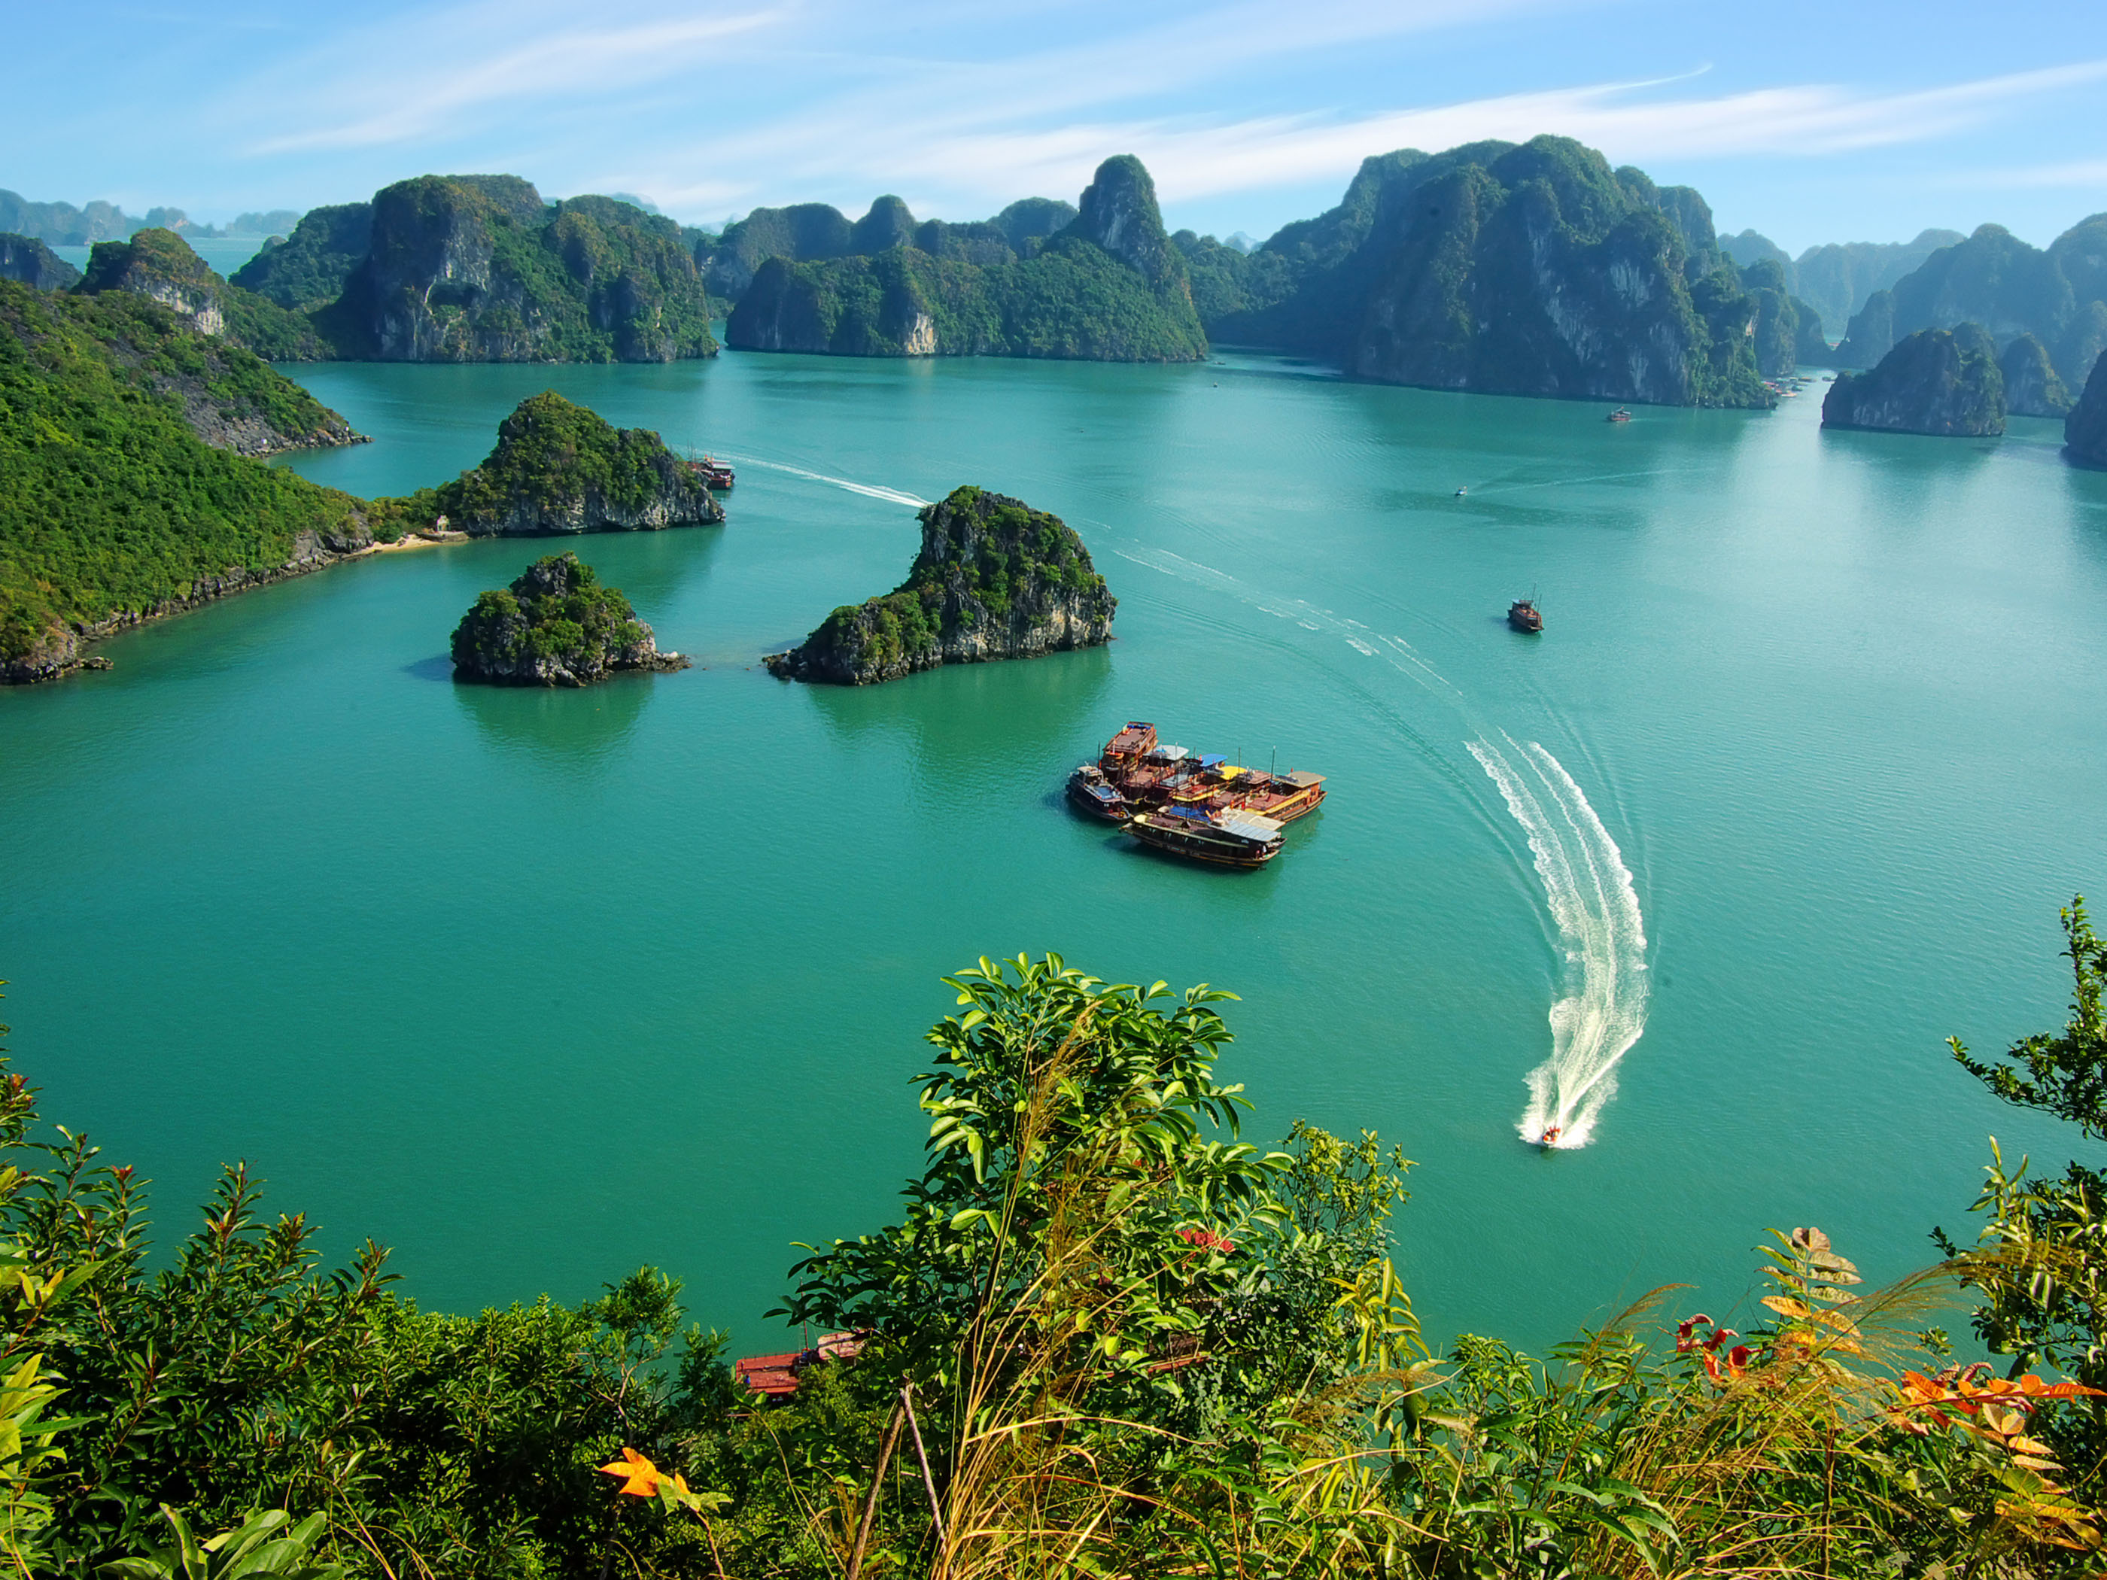
HA LONG BAY
1. It is recognized as a World Heritage Site by UNESSCO
2. It has a lot of caves
3 . It consists of a lot of islands

Slide 7
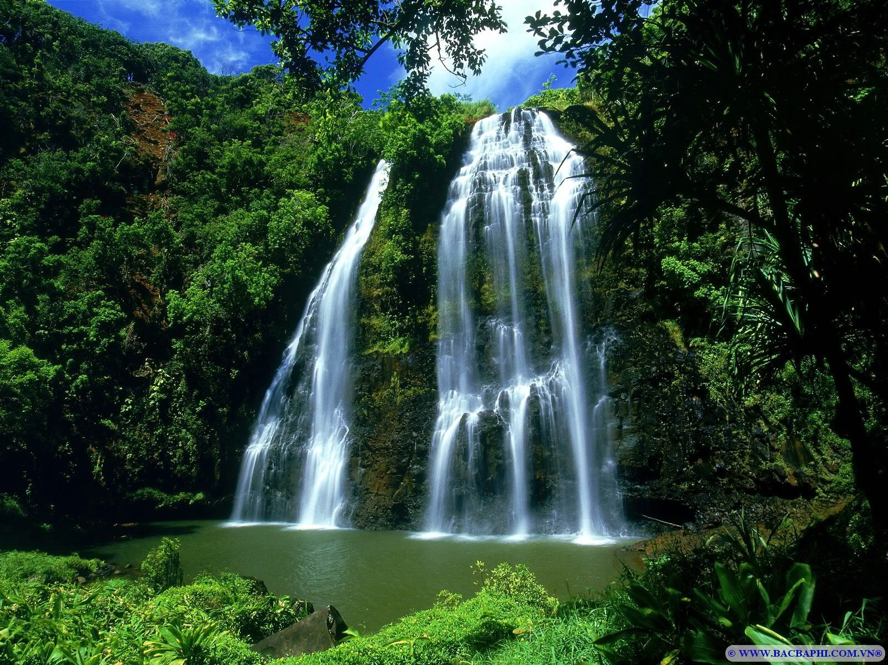
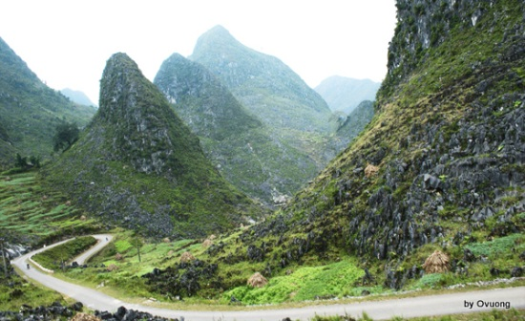
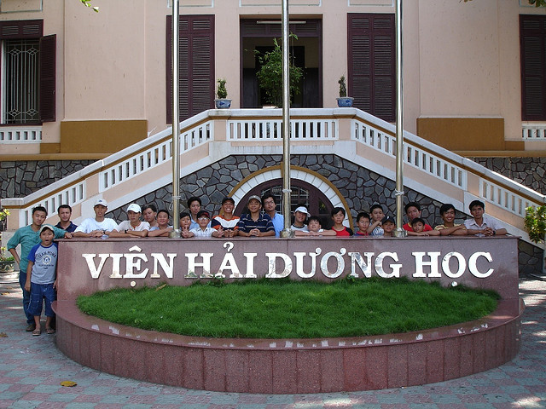
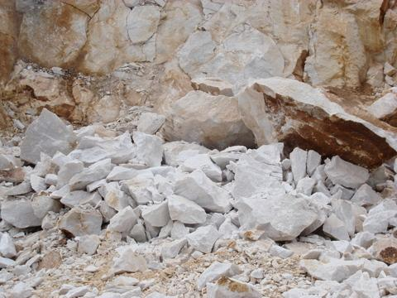
UNIT 11: TRAVELING AROUND VIET NAM
Lesson 3: Read
* New words
- (a) waterfall
: thác nước
- slope (n)
: sườn núi
- tribe (n)
: bộ lạc, bộ tộc
- heritage (n)
: di sản
- (an) oceanic institute
: viện Hải Dương Học
- Limestone (n)
: đá vôi

Slide 8
UNIT 11: TRAVELING AROUND VIET NAM
Lesson 4: Read
Waterfalls
Heritage
Ocean institute
Limestone
Tribe
Slope

Slide 9
UNIT 11: TRAVELING AROUND VIET NAM
Lesson 4: Read
Waterfalls
Heritage
Ocean institute
Limestone
Tribe
Slope

Slide 10
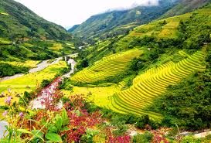
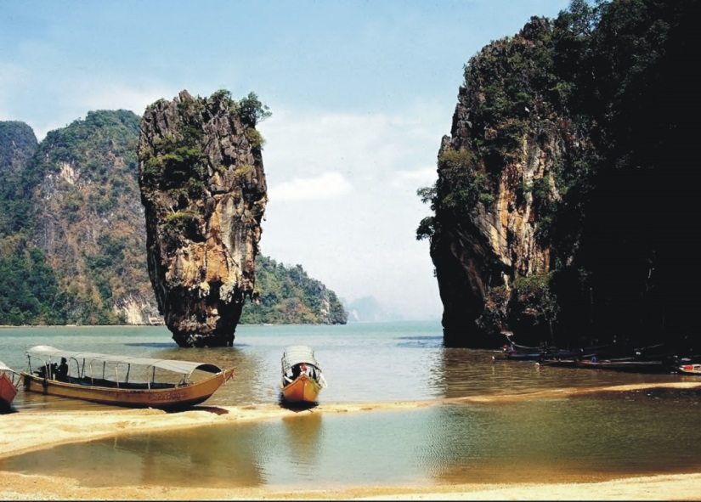
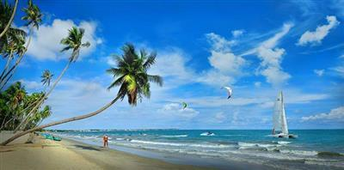
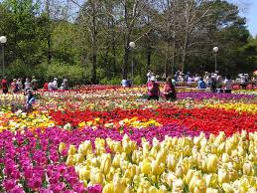
Sa Pa
Ha Long Bay
Nha Trang
Da lat

Slide 11
UNIT 11: Lesson 4: Read
T/F Statements Prediction
T
1. We can go by bus to all of 4 places.
2. In Nha Trang, visitors can visit the Oceanic Institute.
3. There are lots of flower gardens in
Ha Long Bay.
4. We can visit tribal villages in Sa Pa.
5. Da Lat is one of the World Heritage Site.
T
F
Da Lat.
T
T
Ha Long Bay
F

Slide 12
UNIT 11: Lesson 4: Read
Grid
 | Nha Trang | Da Lat | Sa Pa | Ha Long Bay
√
1. caves
√
2. flights to Ha Noi
3. mountain slopes
√
4. railway
√
√
5. sand beaches
√
6. tribal villages
√
7. waterfalls
8. World Heritage
√
Notes:
√ √

Slide 13
Unit 11: Lesson 4: Read
Answer
Where should these people go ?
Nha Trang
Da Lat
Sa Pa
Ha Long Bay
Nha Rong Harbor
Andrew
Mary
John
Joanne
Donna

Slide 14
Unit 11: Lesson 4: Read
Answer
- Where should Andrew go ?
Andrew studies tribes around the world. He likes moutain-climbing.
Nha Trang
Da Lat
Sa Pa
Ha Long Bay
Nha Rong Harbor
V
V

Slide 15
Unit 11: Lesson 4: Read
Answer
- Where should Mary go ?
Mary loves Viet Nam and she wants to travel by train to see as much of the country as possible. She also wants to visit oceanic institute in Viet Nam.
Nha Trang
Da Lat
Sa Pa
Ha Long Bay
Nha Rong Harbor
V

Slide 16
Unit 11: Lesson 4: Read
Answer
- Where should John go ?
John is interested in the history of Viet Nam. He wants to visit the places where President Ho Chi Minh left Viet Nam in 1911.
Nha Trang
Da Lat
Sa Pa
Ha Long Bay
Nha Rong Harbor
V

Slide 17
Unit 11: Lesson 4: Read
Answer
- Where should Joanne go ?
Joanne likes swimming and sunbathing.
She has been to Viet Nam twice and
she has visited Nha Trang already.
Nha Trang
Da Lat
Sa Pa
Ha Long Bay
Nha Rong Harbor
V
V

Slide 18
Unit 11: Lesson 4: Read
Answer
- Where should Donna go ?
Donna is a florist. She has a flower shop in Los Angeles. She is thinking of importing flowers from Viet Nam.
Nha Trang
Da Lat
Sa Pa
Ha Long Bay
Nha Rong Harbor
V

Slide 19
Unit 11: Lesson 4: Read
Answer
Where should these people go ?
Nha Trang
Da Lat
Sa Pa
Ha Long Bay
Nha Rong Harbor
Andrew
√
√
Mary
√
John
√
Joanne
√
√
Donna
√

Slide 20
UNIT 11: Lesson 4: Read
Discussion
Which place are you going to visit ? Why?

Slide 21
- Learn by heart vocabulary & make a brochure like the ones pages 102 , 103 to introduce about your town.
- Prepare new lesson WRITE page 105, 106, 107

Slide 22
GOODBYE

Slide 23
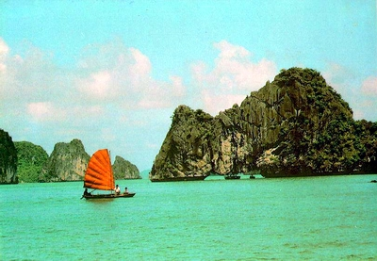
Ha Long Bay
Recognized by UNESCO as a World Heritage Site
Sights
Magnificent caves
Beautiful limestone islands
Quiet sand beaches
Accommodation
Hotels and mini-hotels in Ha Long City and various islands.
Low-priced guest houses in Ha Long City
Arrivals / Departures
Buses and trains daily to and from Hai Phong and Ha Noi

Slide 24
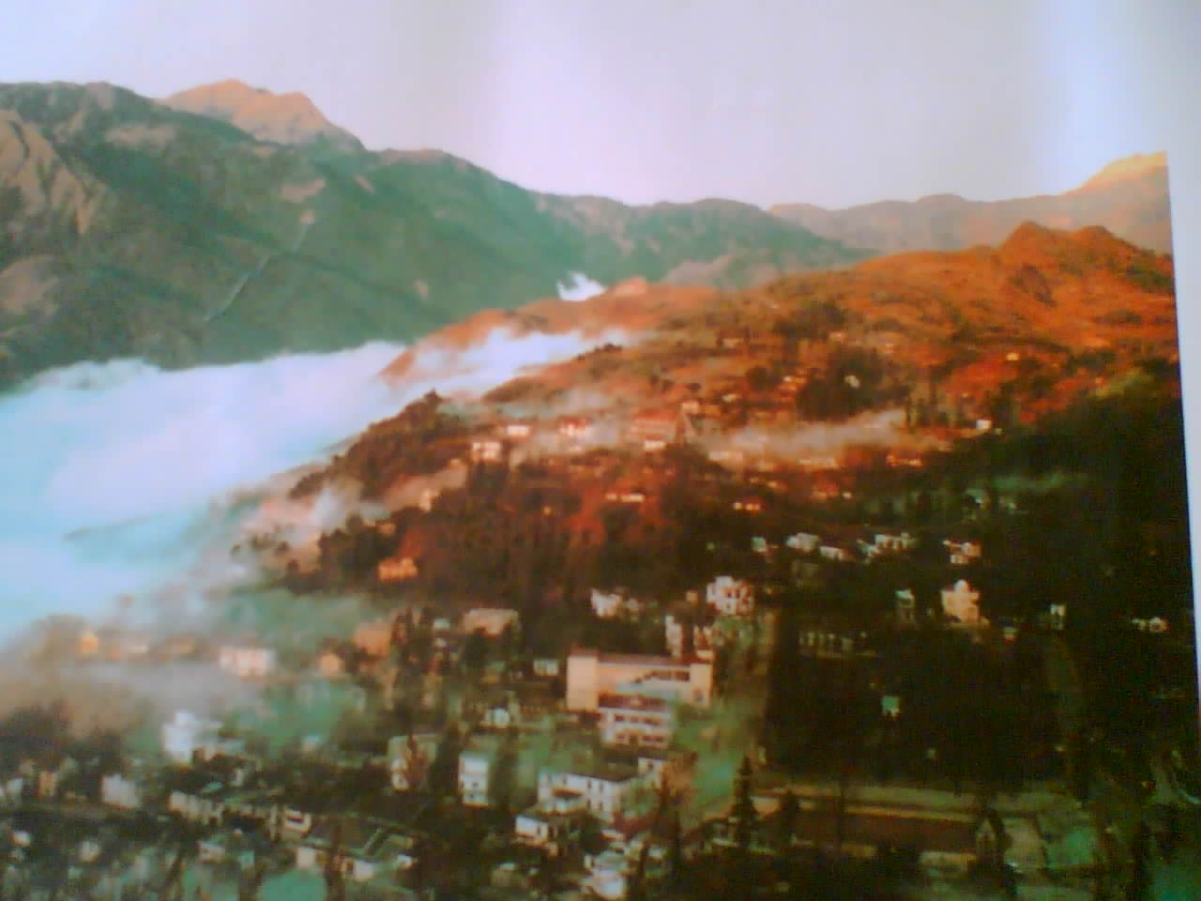
Sa pa
Moutainous resort
Sights
Tribal villages
Beautiful mountain slopes
Jungle streams
Accommodation
Some hotels and guest houses
Arrivals / Departures
Buses daily to Lao Cai Town
Trains daily from Lao Cai to Ha Noi

Slide 25
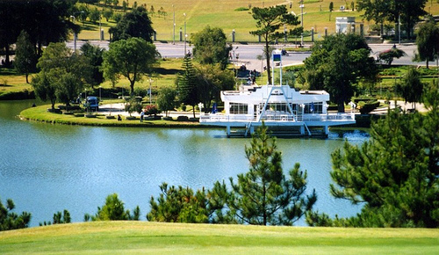
DA LAT
Known as the city of Eternal Spring
Sights
Waterfalls, lakes
Railway
Flower gardens
Accommodation
Many hotels, but difficult to find
accommodation at busy times.
Arrivals / Departures
Flights to and from Ho Chi Minh City three times a week
Buses and minibuses to Nha Trang and Ho Chi Minh City.

Slide 26
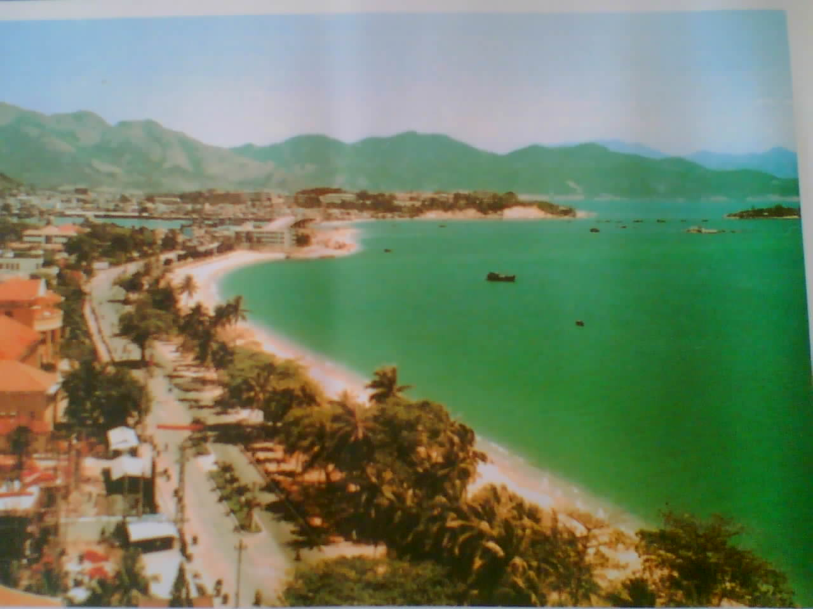
NHA TRANG
Seaside resort
Sights
Oceanic Institute
giant Buddha
offshore Islands
Accomodation:
A small selection of hotels
Arrivals / Departures
Flights daily to Ho Chi Minh City except Monday
Flights to Ha Noi twice a week
Buses and trains to northern and southern destinations

