Slide 1

Welcome to lesson

Slide 2

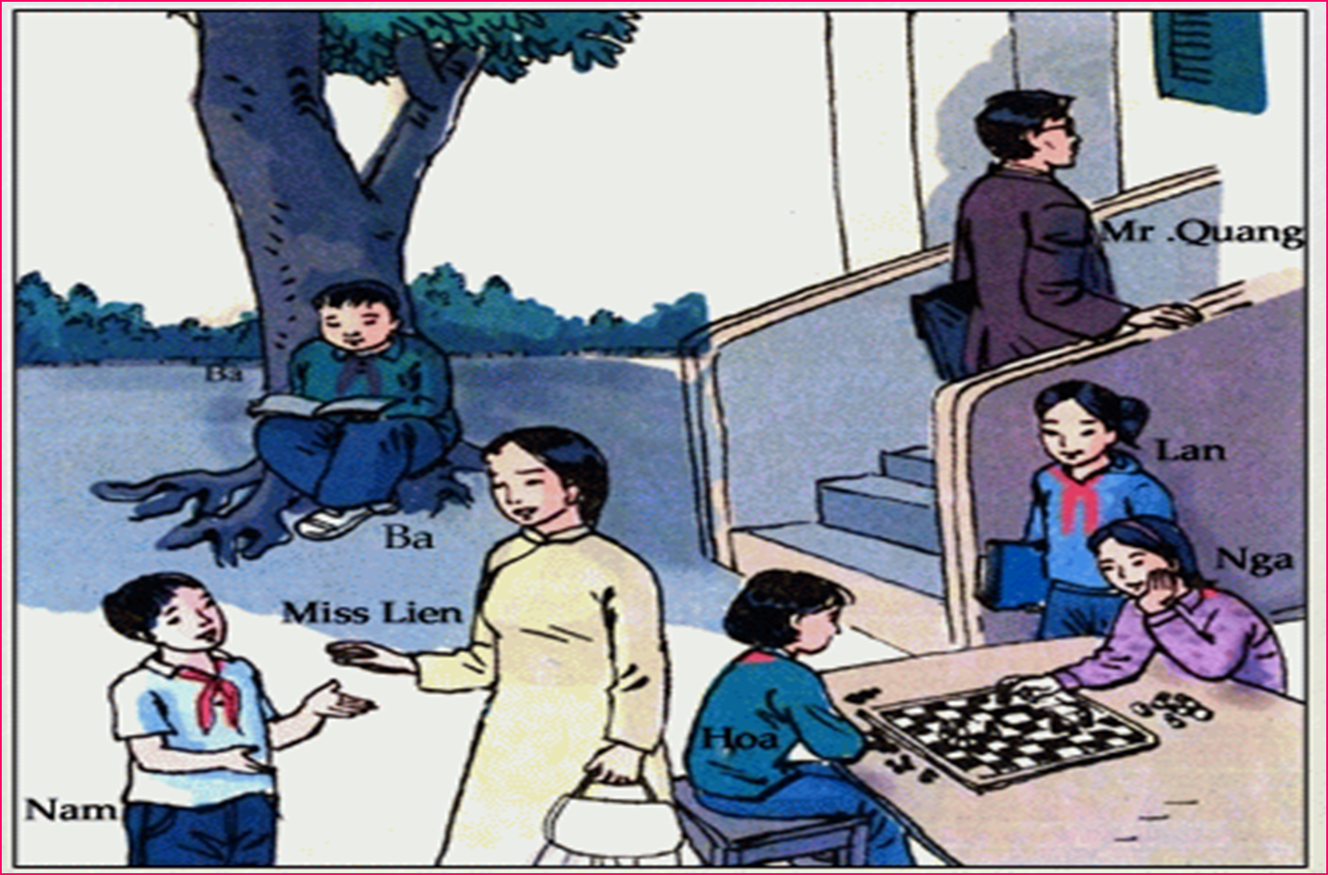
Kim’s game:

Slide 3

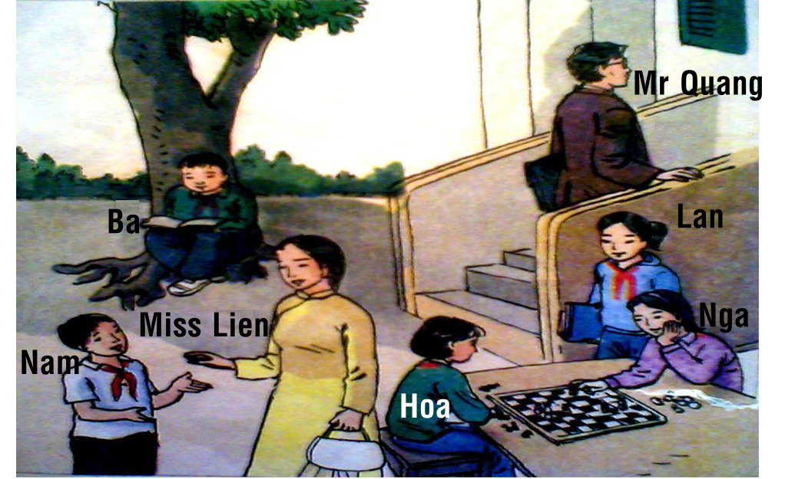
Questions:
1. How many people are there in the picture?
=> There are seven.
2. Who are they?
=> There are Mr. Quang, Ba,Nam,Lan,Miss Lien,Nga and Hoa.
3. Where is Ba? What is he doing?
=> He is under the tree. He is reading a book.
4. Who is Nam talking to?
=> He is talking to Miss Lien.
5. What is Hoa and Nga doing?
=> They are playing chess.

Slide 4
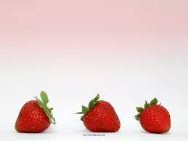

Unit 11: TRAVELING AROUND VIET NAM
Lesson: Language Focus

Slide 5

I.Present participles.
The man walking up the stairs is
Mr. Quang.

The boy reading a book is Ba.
Noun
Present participle phrase
⇦Reading/walking are called present participles.
1.Grammar:
a) Form:
V-ING
b) Use:
A present participle can be used as an adjective to qualify a noun with active meaning.

Slide 6

2) Practice: a)Say who each person is:
b)Answers:
Miss Lien/carry a bag.
2. Nam/talk to Miss Lien.
3.Lan/stand by the table.
4.Nga and Hoa/ play chess.
=>The boy talking to Miss Lien is Nam.
=>The girl standing by
the table is Lan.
=>The girls playing
chess are Nga and Hoa.
EX: S1:Who is the woman carrying a bag?
S2:The woman carrying a
bag is Miss Lien.

Slide 7

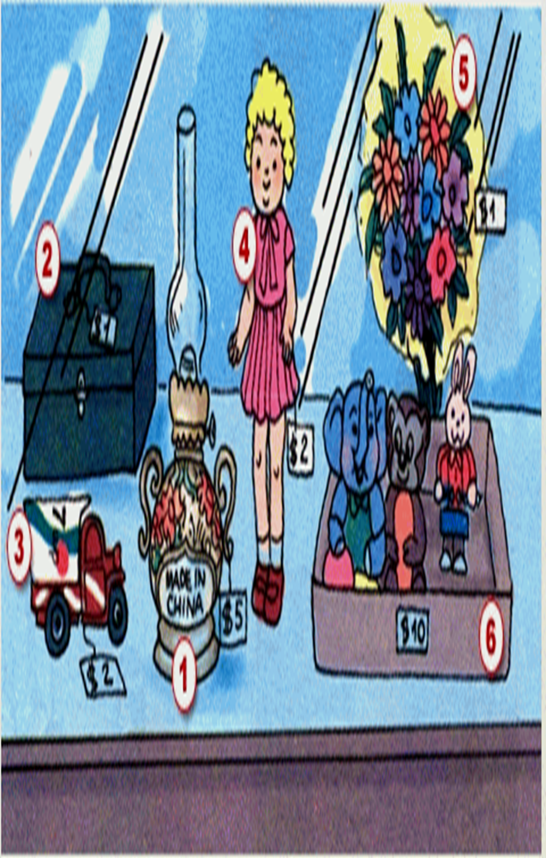
II. Past participles.
1)Matching:
A
B
1)-Box
2)-Truck
3)-Lamp
4)-Doll
5)-Flowers
6)-Toys
a)-wrap in
b)-dress in
c)-recycle from
d)-keep in
e)-make in
f)-paint

Slide 8

2) Model sentence:
The old lamp made in China is five dollars.
Noun
Past participle phrase (Ved/V3)
3) Grammar: Past participle
a) Form:
Ved/ V3
b) Use:
A past participle can be used as an adjective to qualify a noun with passive meaning.

Slide 9

4) Practice:
Fill in the gaps with suitable past participles.
painted
The box ……………… green is one dollar.
The truck ……………….from cans is two dollars.
The doll …………….... in red is two dollars.
The flowers …………………. in yellow paper is one dollar.
The toys ……………… in a cardboard box is ten dollars.
recycled
dressed
wrapped
kept
paint dress keep wrap recycle

Slide 10

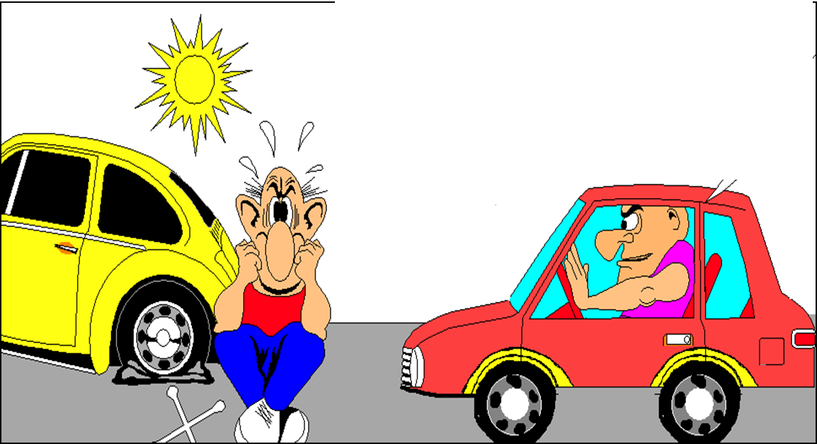
1/ The man ….. in the red car is Jack.
a: sitting
b: sit
c: sat
d: to sit
a: sitting
2/ The car …… down in the street belongs to Tim.
c: broken
d: breaking
a: break
b: broke
c: broken

Slide 11
Would you mind moving your car?
No, of course not.

Slide 12



III. Request with MIND.

Do you mind
Would you mind
+ V-ing …? Bạn có phiền …?
Reply:
- Agree:
No, I don’t mind.
No, of course not.
Not at all.
- Disagree:
I’m sorry, I can’t.
I’m sorry. That is not possible.

Slide 13

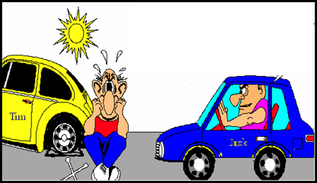
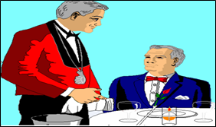
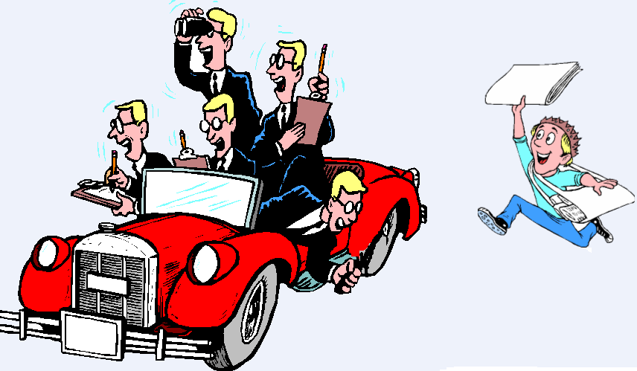
*Use these words to make and respond to requests.
a) move / car ✓
c) get / coffee X
Would / Do you mind moving your car?
No, of course not.
b) put out / cigarette ✓
d) wait / moment X

Slide 14


Would / Do you mind putting out your cigarette?
No, of course not.
b) put out / cigarette ✓

Slide 15
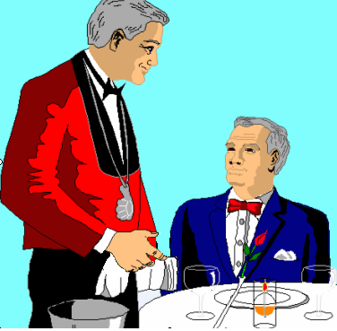

c) get / coffee X
- Would / Do you mind getting me some coffee?
- I’m sorry. I can’t.

Slide 16
d) wait / moment X
- Would / Do you mind waiting for me a moment?
- I’m sorry. That is not possible.

Slide 17

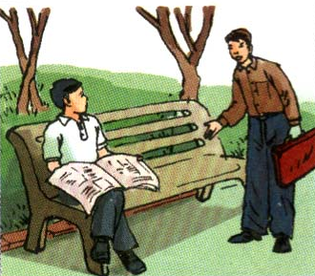
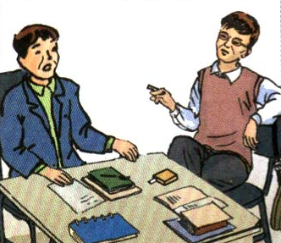
a)
b)
Sit down
smoke
Request: Do you mind if I sit down?
Response: Please do.
b). Request: Would you mind if I smoked?
Response: I’d rather you didn’t.

Slide 18



III. Request with MIND.
2/ Do you mind if + S + …(simple present tense)?
Would you mind if + S + …(simple past tense)?
Bạn có phiền nếu (ai) (làm gì)?
Reply:
-Agree:
Please do / Please go a head.
-Disagree:
: I’d prefer you didn’t.
I’d rather you didn’t.

Slide 19

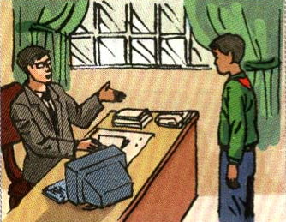
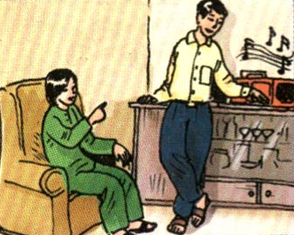
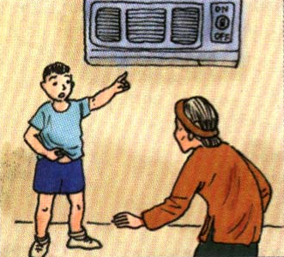
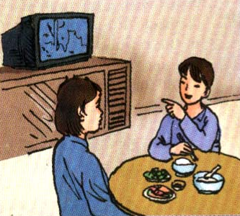
* Ask questions and give suitable responses.
Postpone our meeting
Turn off the radio
Turn on the air conditioner
Watch TV while eating lunch

Slide 20
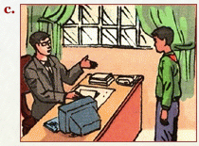
Practices:
Do you mind if I postpone our meeting?
Not at all

Slide 21
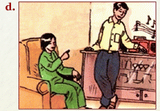
Would you mind if I turned off the radio ?
Practices:
I’d rather you didn’t.

Slide 22
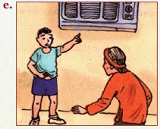
Practices:
Do you mind if I turn on the air –conditioner ?
Please do.

Slide 23
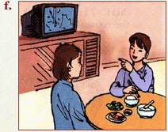
Practices:
Would you mind if I watched TV white eating lunch ?
I’d prefer you didn’t.

Slide 24


Lucky Number
1
3
2
4
5
7
6
8

Slide 25


The boy … to Miss Lien is Nam.
a: talk
b: talking
c: to talk
b
Sorry
Sorry

Slide 26

The case … green is one dollar.
a: painted
b: painting
c: to paint
a

Slide 27
Do you mind … me some coffee?
a: get
b: getting
c: got
b

Slide 28
Would you mind … out your cigarette?
a: put
b: putting
c: to put
b

Slide 29
Do you mind if she … on the air conditioner?
a: turns
b: turning
c: to turn
a

Slide 30
Would you mind if I …?
a: smoke
b: smoking
c: smoked
c

Slide 31
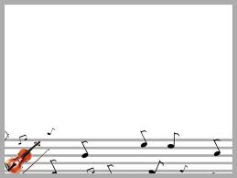


Congratulate

Slide 32
Congratulate

Slide 33

HOMEWORK
- Learn the structures and do the exercises again.
- Prepare Unit 12: A VACATION ABROAR – Getting started + Listen and read.
?
Which country do you want to visit? Why?

Slide 34
